Slide 1

Data Acquisition System Project
Giovanni De Angelis
IST197634

Slide 2
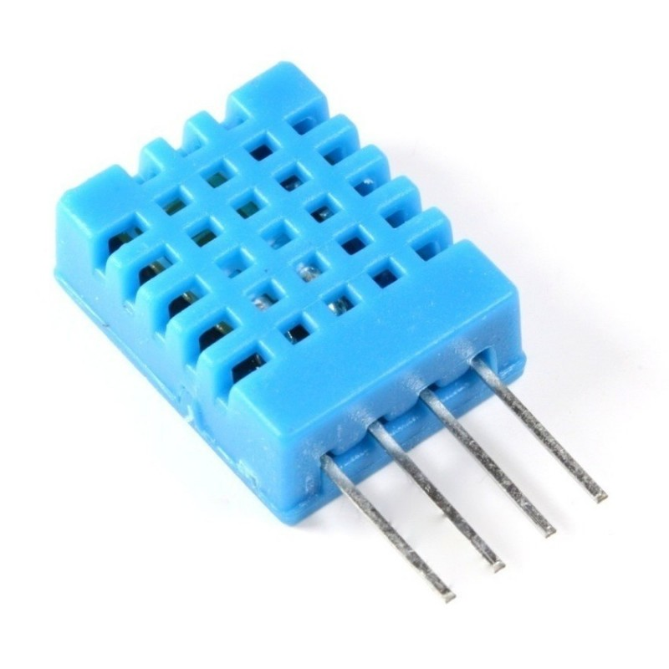
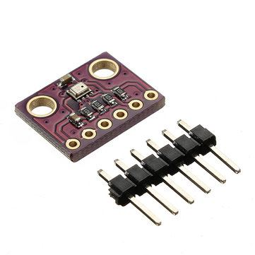
Components: input sensors
Temperature and humidity sensor DHT11
Pressure sensor BMP280

Slide 3
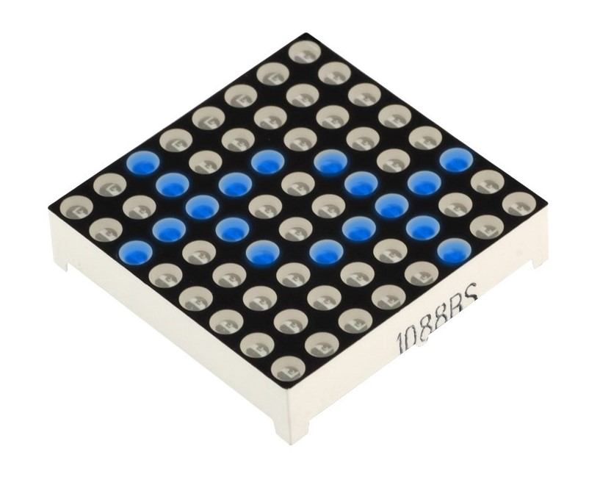
Components: outputs
Serial monitor
LED matrix

Slide 4

Function part 1
Read temperature, humidity, pressure
Show the parameters on the serial monitor using UART code

Slide 5

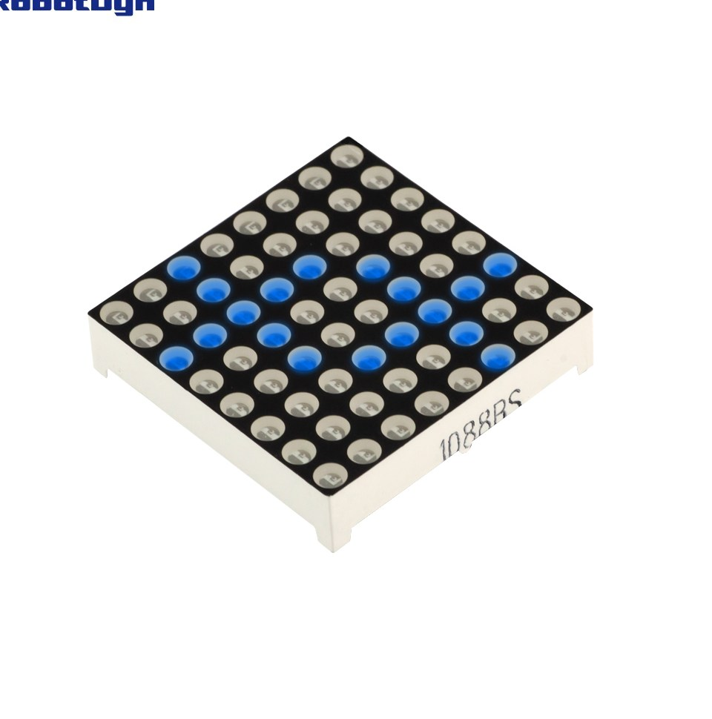

Function part 2
By means of a model based on humidity and pressure define how the wheter will be
Show on the LED matrix a cloud or a sun in order to inform the user

Slide 6
Steps
Set up the circuit
Code the acquisition of the data from the two sensors used
Write down the mathematical model
Test the performances of the system
Make changes in the code in order to optimize the performances

Slide 7
